Slide 1
Answer Bot
Mission 8

Slide 2

Pre-Mission Preparation
In the last mission, the person running the program had control over what happened. In real-life, sometimes values need to be random.
What are some examples of when you might need something random?

Slide 3

Mission 8: Answer Bot
In this project you will create a random answer generator.
Instead of selecting messages yourself, like in the previous project, you will have the computer decide for you!
→ Just press a button and let your Answer Bot decide :-)

Slide 4
Objective #1: Display a number
Review displaying an integer from Mission 4
Start this project by writing code that will:
  Assign a variable an integer value
  Display the variable

Slide 5
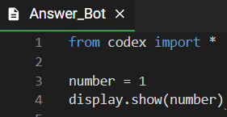
Mission Activity #1
DO THIS:
Start a new file named
Answer_Bot
Import the codex module
Assign number the value 1
Use display.show() with number
  Use CodeTrek if you need help
This will cause an error – do you recognize the error before you run the code?

Slide 6
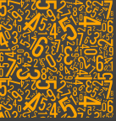
Objective #2: Fix it up
In Mission 4, you learned two ways to fix the error:
Convert (change) the integer to a string
  str(number)
Use display.print(number)
  Automatically converts the integer to a string

Slide 7
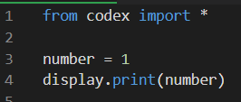
Mission Activity #2
DO THIS:
Change display.show(number) to display.print(number)

Slide 8
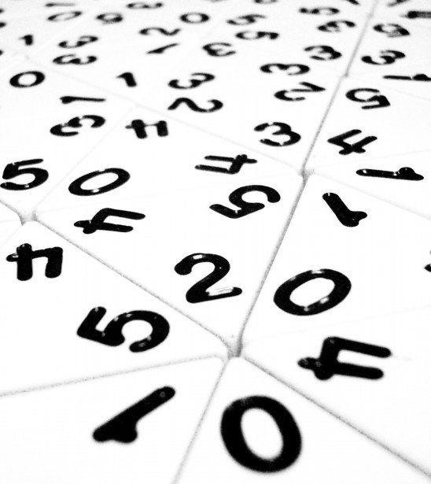

Objective #3: Randomize!
Python has a random module that has built-in functions
Import the random module to access the functions
One of the built-in functions is randrange
The function call looks like this:
  random.randrange(end_value)

Slide 9
Objective #3: Randomize!
The randrange function returns a random integer between 0 and one less than the end value
Examples:
  number = random.randrange(10)
  Gives a random number from 0 to 9
  number = random.randrange(5)
  Gives a random number from 0 to 4

Slide 10

Objective #3: Randomize!
The randrange function generating a random integer between 0 and one less than the end value is really handy!
The list index starts at 0 and goes to one less than the number of items
If you have a list with 6 items, you can get a random index by using
Or, avoid the magic number:

Slide 11
Objective #3: Randomize!
One more thing: You can make your print bigger!
display.print() has an argument for scale
display.print(number, scale=1)
scale=1 is the normal size
scale=2 makes the text bigger
scale=3 makes the text even bigger
If you make the scale too big, the text won’t fit on the screen
Instead it will look like weird shapes
  If this happens, you know the scale is too big

Slide 12
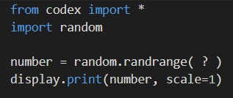
Mission Activity #3
What number goes here?
DO THIS:
Change the value of number to a
random number between 0 and 9
Add a scale argument to the
display.print() statement: start with scale=1
Run the code, then change the scale: scale=3
Run the code, then change the scale to a different number
Run the code several times. You should get a different random number each time.
NOTE: Sometimes you may see the same number repeat, but that's all part of the randomness!

Slide 13
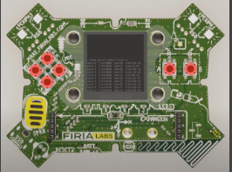
Objective #4: Mix things up
You can improve the code by using a CodeX button and a loop.

Slide 14
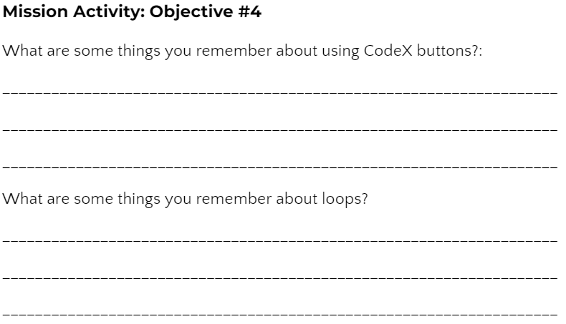
Mission Activity #4
DO THIS:
Go to your Mission Log and write down what you remember about CodeX buttons and loops

Slide 15
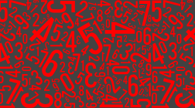
Objective #4: Mix things up
Running the program every time you want a random number isn’t very fun.
Modify your code to:
Use a loop
Get a random number every time BTN_A is pressed

Slide 16
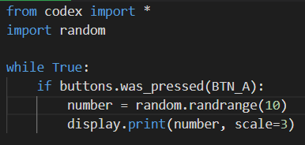
Mission Activity #4
Modify your code
DO THIS:
Add a while True: loop
Add code to check for a button press (BTN_A)
Run the code and press BTN_A several times
You should see a random number each time you press the button
Add code for checking a button press

Slide 17
Objective #5: Robot opinion
Now that you can display a random number, can you display a random text from a list?
Time to give CodeX an opinion!
Think of a question you want CodeX to answer
Then display a random answer
This is a perfect place for a list
Use a random number for the index

Slide 18
Objective #5: Robot opinion
This is your Answer Bot, so you can choose the question you want it to answer
It could be
  Favorite sports team
  Best singer / band
  Favorite food
  Magic 8 Ball answers
  Best subject in school
  You decide!

Slide 19
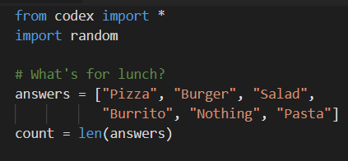
Mission Activity #5
Put your own question and possible answers here
DO THIS:
Go to the Mission Log and plan your question and several possible answers
Modify the code by creating
a list in your code with the possible answers
Assign a variable the number of items (len of list)

Slide 20
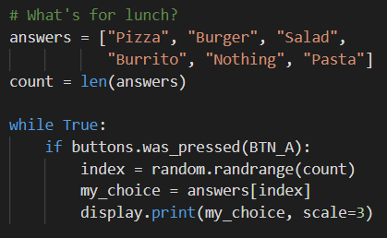
Mission Activity #5
DO THIS:
Modify the if statement to:
  Get a random number for the index
  Assign a variable the value from the list
  Display the list item variable (adjust the scale if needed)

Slide 21

Get some answers
During this mission you have learned how to import another module and use it to get random integers that you can use with a list.
Answer 2 quiz questions about the Objectives 1-5
CODEX
QUIZ

Slide 22
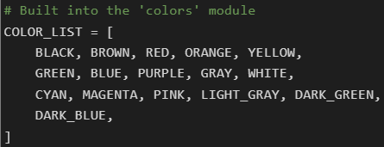
Objective #6: Wait for answer
The CodeX module has a built-in list for colors - no need to create one.
You do not need to type this in your code
You can use this list to select a random color for the pixels.
Let the pixels cycle through random colors while you wait for an answer!

Slide 23

Objective #6: Wait for answer
Working with the built-in COLOR_LIST:
len(COLOR_LIST) will give you the number of items in the list
Use len(COLOR_LIST) to get a random number
Use the random number to get a color from the list
Use the color to turn on the pixels

Slide 24
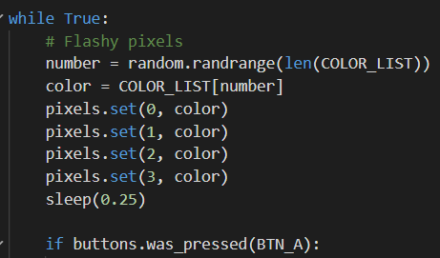
Mission Activity #6
Put it all together!
DO THIS:
Import sleep
Get a number for a random pixel color
Use the number to get a color from the COLOR_LIST
Use the color to turn on all the pixels
Use a short sleep to make the pixels flash

Slide 25
Objective #7: Choices, choices
Four flashing pixels is … flashy!
What about making the four pixels flash different colors instead of the same color?
You just have to assign a random color to each pixel
This could take a few lines of code, so…
There is a simpler way

Slide 26
Objective #7: Choices, choices
Another built-in random function
You already know about random.randrange()
Another built-in function is random.choice()
It will randomly pick an item from a list –
  No need to use a number or index variable
It looks like this:

Slide 27
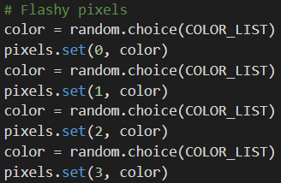

Objective #7: Choices, choices
Another built-in random function
You can use this command, one for each pixel:
Do you think you can use random.choice() for your answers list as well?

Slide 28
Mission Activity #7
DO THIS:
Delete the two lines of code that use random.randrange()
  One for color
  One for answers
Delete the count variable (not needed anymore)
Modify the code for color and my_choice to use random.choice()
Get four random colors and use each one in a different pixel
Use the code snippets on the previous slide if you need help

Slide 29
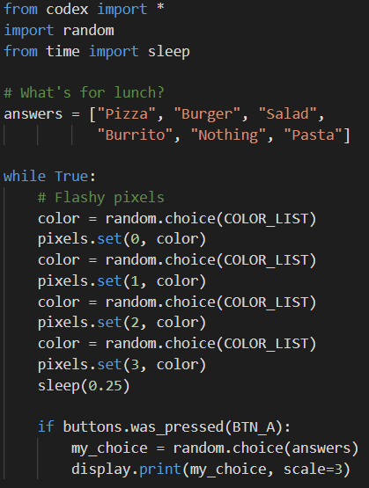
Mission Activity #7
DO THIS:
Does your code look similar to this?
Did you pass off your two goals?

Slide 30
Post-Mission Reflection
Read the “completed mission” message and click to complete the mission
Complete the Mission 8 Log

Slide 31
Clearing your CodeX
Go to FILE -- BROWSE FILES
Select the “Clear” file and open it
Run the program to clear the CodeX

